Slide 1

Remote Control of Agricultural Irrigation Motors Using GSM and Arduino
Done by:
Aade Hruthik Chandra (43614001)
MENTOR
Dr. K. VEENA M.E, Ph.D.
Associate Professor
Department of Computer Science Engineering

Slide 2
AGENDA
Abstract
Objective(s)
Empathize
Problem Definition
Ideation
Introduction
Existing model
Proposed Model
Feasibility study
Components/Hardware requirement & Assembling
Software requirements
Prototype and Implementation
Testing
Feedback
Applications
References

Slide 3
ABSTRACT
This project introduces a GSM-based remote motor control system for agricultural irrigation, enabling farmers to operate water pumps using SMS commands. Utilizing an Arduino Uno, GSM module (SIM800L/SIM900), relay, and a water pump, the system provides remote accessibility, real-time status updates, and efficient water and energy management. It's designed to be low-cost and easy to deploy, especially for small and medium-scale farmers, encouraging smart and sustainable agricultural practices.

Slide 4
OBJECTIVE(S)
To design and develop a GSM-based remote irrigation control system.
To allow farmers to switch irrigation motors ON/OFF via SMS commands.
To reduce dependency on manual labor and ensure effective water usage. To provide real-time motor status feedback.
To keep the system scalable for future integration with IoT and automation using sensors.

Slide 5
EMPATHIZE
Understanding the daily struggles of farmers—especially those in rural areas with limited access to resources—helped identify the need for a solution that allows remote operation of irrigation systems. Many farmers travel long distances or work under harsh conditions to manually control water supply, leading to physical strain and inefficient water usage. Our solution aims to relieve this burden.

Slide 6
PROBLEM DEFINITION
Traditional irrigation systems require farmers to be physically present to start or stop motors, which is labor-intensive and inefficient. This leads to water wastage, energy loss, and increased operational costs. There's a need for an affordable, easy-to-use remote control solution that can function in areas with limited internet connectivity.

Slide 7
IDEATION
1. IoT-Based Control: Uses Wi-Fi modules and apps for real-time motor control and automation. Needs stable internet, higher cost, and complex setup.
2. Bluetooth Control: Connects to the motor via a smartphone within a short range. Simple and offline, but limited to 10–15 meters.
3. GSM-Based SMS Control (Selected): Uses Arduino with a GSM module to receive SMS commands. No internet needed, long-range, low cost, ideal for rural use.

Slide 8
INTRODUCTION
Agriculture is the backbone of many economies, and irrigation is a critical aspect of farming. With advancements in embedded systems and wireless communication, modernizing irrigation through automation and remote control can vastly improve productivity and sustainability. This project presents a GSM-based solution that allows for efficient water management without relying on internet access.

Slide 9
EXISTING MODEL
Several existing solutions use manual switches or internet-based control systems. These have limitations such as physical labor requirements or dependency on stable internet, which may not be feasible in rural areas. While IoT solutions exist, they are often costly and complex to set up.

Slide 10
PROPOSED MODEL
The proposed system uses an Arduino Uno connected to a GSM module (SIM800L or SIM900), a relay module, and a DC water pump. When an SMS command is received, the Arduino interprets it and activates the motor accordingly. The system can send a confirmation SMS indicating motor status, providing immediate feedback to the user.

Slide 11
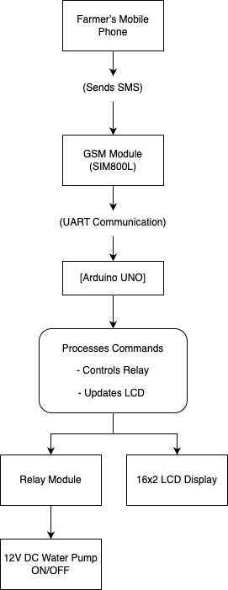
ARCHITECTURE
Architecture Diagram of Remote Control of Agricultural Irrigation Motors Using GSM and Arduino

Slide 12
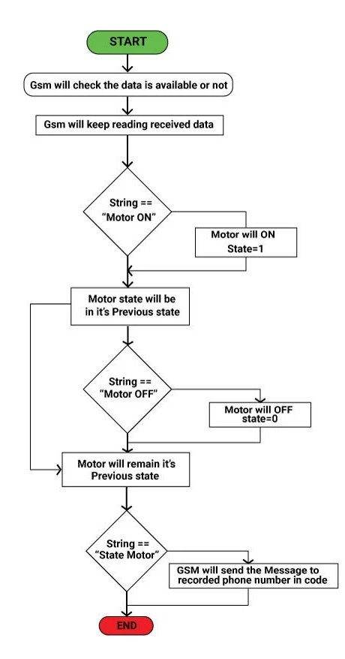
FLOW DIAGRAM
Flow Diagram of Remote Control of Agricultural Irrigation Motors Using GSM and Arduino

Slide 13
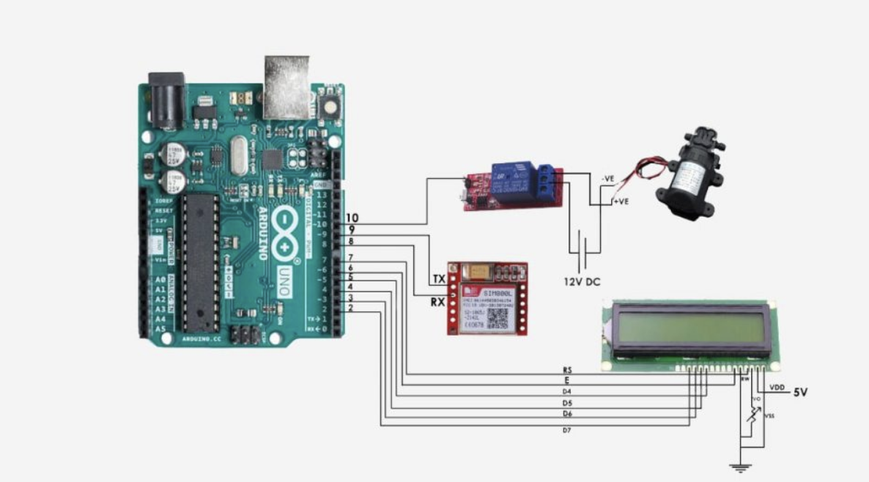
CIRCUIT DIAGRAM
Relay Module
Water Pump R385
LCD Display
GSM Module
Arduino Uno R3
Circuit Diagram of Remote Control of Agricultural Irrigation Motors Using GSM and Arduino

Slide 14
FEASIBILITY STUDY
Technical Feasibility The system uses simple, reliable components like Arduino and GSM modules. It is easy to assemble, program, and maintain with basic technical skills.
Economic Feasibility All hardware is low-cost and widely available. The system is affordable, especially for small and medium-scale farmers.

Slide 15
TECHNICAL FEASIBILITY
This solution is technically viable using proven, reliable hardware like Arduino Uno, SIM800L GSM module, and relay drivers.
It supports long-range SMS communication, even in remote areas without internet.
The system is modular and easy to upgrade, with potential for future enhancements like soil moisture sensors, IoT integration, or mobile app support. Documentation and support for components are widely available, ensuring easy assembly, troubleshooting, and scalability.

Slide 16
ECONOMICAL FEASIBILITY
The system is built using affordable, off-the-shelf components like Arduino, GSM modules, relays, and DC pumps.
Total project cost is minimal compared to commercially available smart irrigation solutions.
It does not require ongoing subscriptions or high maintenance, making it cost-effective over time.
The savings in water, electricity, and labor costs ensure a quick return on investment, especially for farmers with limited budgets.

Slide 17
MARKET FEASIBILITY
India has a large population of small and medium-scale farmers who often lack access to advanced irrigation technologies. This GSM-based motor control system provides a low-cost, easy-to-use solution tailored to their needs. With increasing awareness and government push toward smart farming and water conservation, the market for such systems is growing. The product has high adoption potential in rural and semi-urban areas where mobile networks are available but internet access is limited.

Slide 18
OPERATIONAL FEASIBILITY
The system is designed to be simple and highly practical for day-to-day use in agricultural fields. Farmers can turn motors ON or OFF using basic SMS commands from any mobile phone, without needing internet connectivity or smartphones. It requires minimal training, and instructions can be learned quickly. Since the system gives real-time feedback through SMS, farmers can monitor the motor’s status from anywhere, increasing convenience and reducing manual effort.

Slide 19
LEGAL FEASIBILITY
The project operates within the legal framework defined for telecommunication devices in India. It uses GSM technology, which complies with existing telecom regulations regarding frequency usage and device certification. There are no legal restrictions on using GSM modules for sending and receiving SMS for agricultural purposes. The system does not interfere with licensed spectrum or require special government approvals, making it fully compliant and safe to implement.

Slide 20
COMPONENTS/HARDWARE REQUIREMENTS & ASSEMBLING
Hardware:
Arduino Uno R3 with USB Cable
SIM800L GSM Module with Antenna
LCD1602 Display
Jumper Wires (65 pcs)
5V Relay Module (1 Channel)
DC 6-12V R385 Water Pump
12V 2A Power Supply (with 5.5mm DC plug)
Assembly:
Connect the GSM module to the Arduino (TX, RX, and power pins).
Connect the relay module to control the water pump.
Attach the LCD display for real-time monitoring.
Use jumper wires for clean and safe connections.
Power the system using a stable 12V 2A supply.

Slide 21
STANDARD SPECIFICATION(BIS)
The system uses components that follow BIS (Bureau of Indian
Standards) guidelines to ensure safety, quality, and durability in
agricultural use.
Wires: IS:694 – PVC insulated wires up to 1100V.
Water Pump: IS:8472 – Centrifugal pumps for agriculture.
Relays & Power Supply: ISI-marked for electrical safety.
Using ISI-certified components ensures reliable performance and protection in field conditions.

Slide 22
SOFTWARE REQUIREMENTS
Arduino IDE for code development and uploading.
GSM library for SMS command handling.
LCD library for displaying system status.
Serial monitor (optional) for debugging.

Slide 23
PROTOTYPE AND IMPLEMENTATION
The prototype was assembled on a breadboard for initial testing. The Arduino was programmed to receive SMS messages, interpret ON/OFF commands, and activate the relay accordingly. The LCD displays the current status of the motor. Once confirmed functional, the system was enclosed in a protective casing for real-world use.

Slide 24
TESTING
The system was tested for:
SMS command recognition
Relay switching accuracy
Motor response time
Power stability
Message feedback reliability
Multiple test cases ensured that the motor responded correctly to both ON and OFF commands and that status updates were consistently received.

Slide 25
FEEDBACK
Initial feedback from farmers and educators highlighted the system's simplicity, cost-effectiveness, and practical benefits. Suggestions for improvements included moisture sensor integration and mobile app control, which are planned for future upgrades.

Slide 26
APPLICATIONS
Remote irrigation control in farms
Garden and greenhouse automation
Water supply management in remote locations
Low-cost smart farming for rural communities

Slide 27
REFERENCES
1. Jain, A., & Agarwal, S. (2017). "GSM based automatic irrigation control system for efficient water management." International Journal of Innovative Research in Science, Engineering and Technology, 6(6), 10456–10461.
2. Kumar, V., & Singh, R. (2019). "Smart irrigation system using Arduino and GSM module." International Journal of Scientific Research and Engineering Development, 2(5), 372–375.
3. Patil, A., & Shinde, S. (2020). "Automated irrigation system using GSM module." International Journal of Advance Research and Innovative Ideas in Education, 6(3), 987–990.
4. Shinde, M., & Mane, P. (2018). "Agriculture automation using GSM and Arduino." International Journal of Engineering Research and Technology, 7(10), 1–4.

Slide 28
THANK YOU
We thank God, Our Department, Mentor, Panel Members, Supportive Professors and all Technical and non Technical staff who helped us in our Product Development.

